Slide 1

InTract for Hotel de Bordeaux
A social media for midterm assignment.
Utilized for hotel reviews.

Slide 2
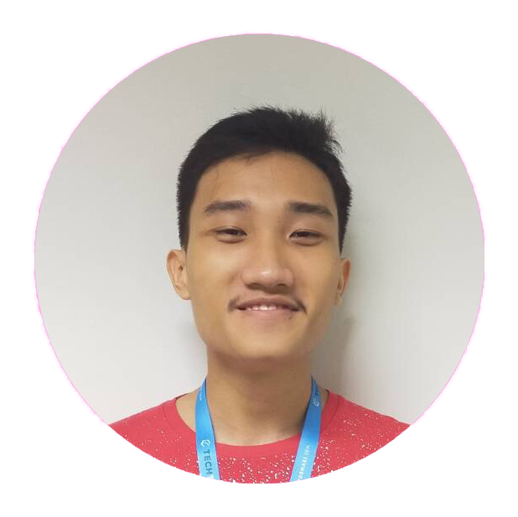
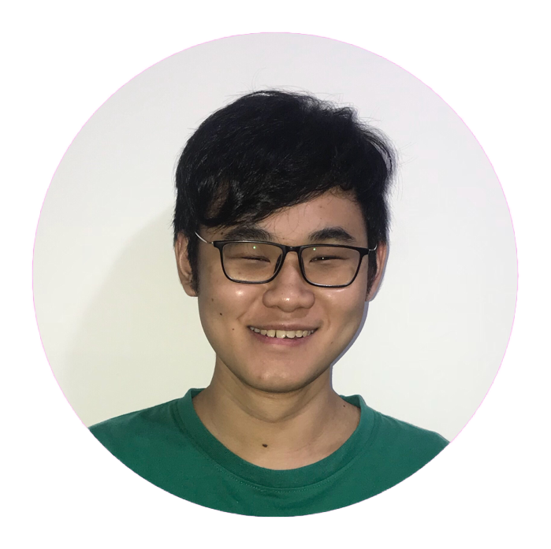
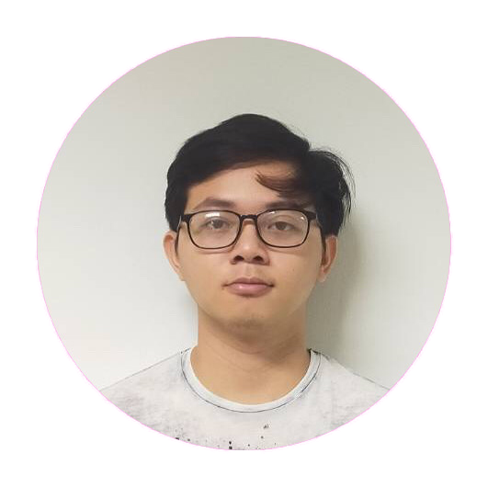
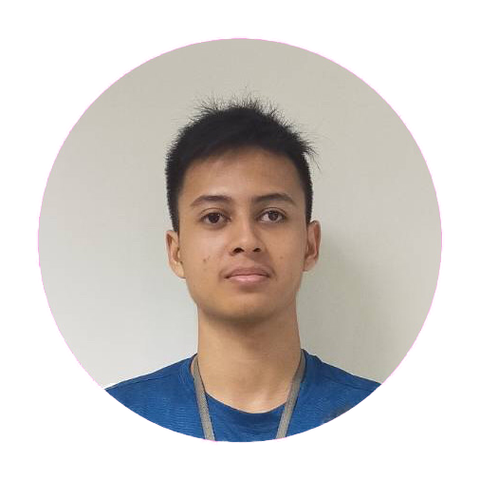
Our Team
Nicholas Dwiarto W
Sebastian
Sinzie Winata
Attar Kusuma P
00000032827
00000031862
00000031729
00000032871

Slide 3
Progress
Sudah selesai.

Slide 4











Technologies

Slide 5




Job Desc
Sign Up
Log In
Nicholas, Sebastian
Nicholas, Sinzie
Profile
Misc. Features, UI
Nicholas (Post, Comments, Search)
Attar (Display Profile, Display Picture)
Nicholas (Misc Features, Git, SCSS)
Attar, Ian, Sinzie (Assets)

Slide 6
Next Update
Perbaikan UI (Captcha)
Optimisasi Code
Display Picture UI
Login menggunakan E-mail
Hosting

